Slide 1


Slide 2


BLOOD RELATIONS

Slide 3
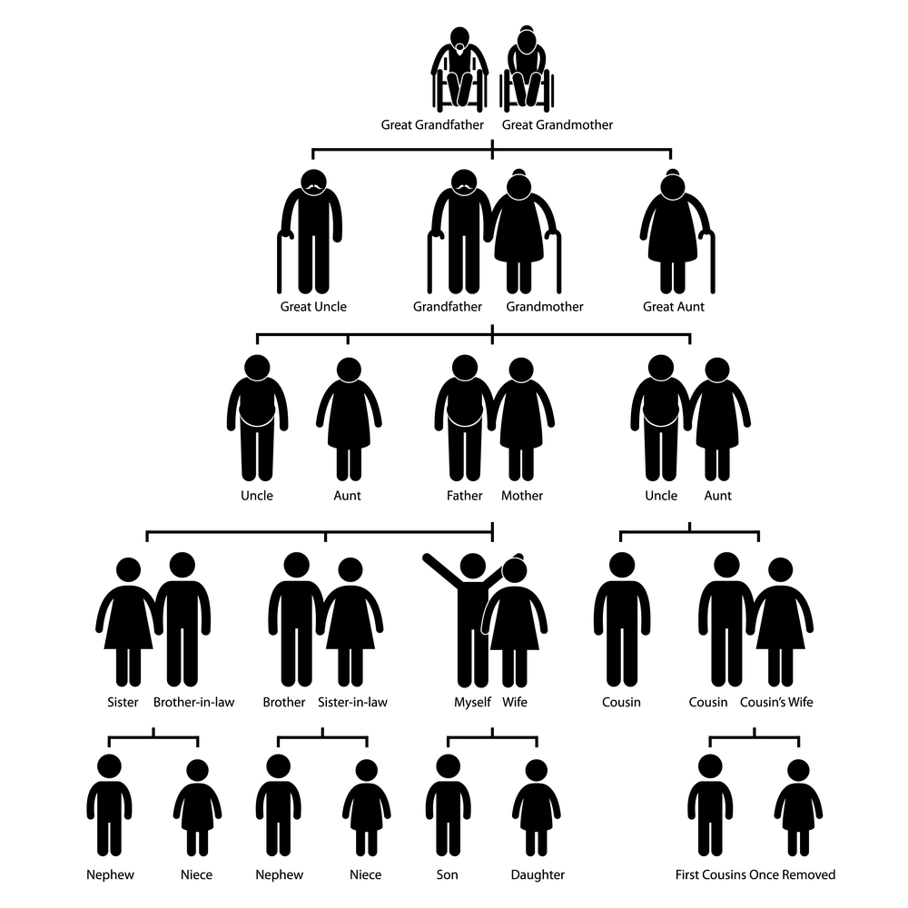

Slide 4
BLOOD RELATIONS
A person who is related to another by birth rather than by marriage.
Important Blood Relations
1. Mother’s (or) Father’s Daughter – Sister 2. Daughter’s husband – Son in law 3. Mother’s brother – Maternal Uncle 4. Mother’s (or) father’s son – Brother 5. Mother’s (or) Father’s sister – Aunt 6. Mother’s (or) Father’s father – Grand Father 7. Sister’s husband – Brother in law 8. Husband’s (or) Wife’s mother – Mother in law

Slide 5
BLOOD RELATIONS
Important Blood Relations
9. Mother’s (or) Father’s mother – Grand Mother 10. Son’s wife – Daughter in law 11. Brother’s (or) Sister’s daughter – Niece 12. Husband’s (or) Wife’s father – Father in law 13. Husband’s (or) Wife’s brother – Brother in law 14. Father’s Brother – Paternal uncle 15. Husband’s (or) Wife’s sister – Sister in law 16. Brother’s (or) Sister’s son – Nephew

Slide 6
Question: 01
Introducing a woman, Shashank said, "She is the mother of the only daughter of my son." How that woman is related to Shashank?
A.Daughter
B.Sister-in-law
C.Wife
D.Daughter-in-law
Answer: D

Slide 7
Explanation:
The woman is the mother of Shashank's granddaughter. Hence, the woman is the daughter-in-law of Shashank.

Slide 8
Question: 02
Pointing to a photograph of a boy Suresh said, "He is the son of the only son of my mother." How is Suresh related to that boy?
A. Brother
B. Uncle
C. Cousin
D. Father
Answer: D

Slide 9
Explanation: 02
The boy in the photograph is the only son of the son of Suresh's mother i.e., the son of Suresh. Hence, Suresh is the father of boy.

Slide 10
Question: 03
Deepak said to Nitin, "That boy playing with the football is the younger of the two brothers of the daughter of my father's wife." How is the boy playing football related to Deepak?
Son
Brother
Cousin
Nephew
Brother-in-law
Answer: B

Slide 11
Explanation: 03
Father's wife - Mother; Mother's daughter - Sister; Sister's younger brother - My younger brother. So, the boy is Deepak's brother.

Slide 12
Question: 04
Pointing to a photograph, a woman says, "This man's son's sister is my
mother-in law." How is the woman's husband related to the man in the photograph?
Grandson
Son
Son-in-law
Nephew
Answer: A

Slide 13
Explanation: 04
Man's son's sister - Man's daughter. So, the man's daughter is the mother of the woman's husband. Thus, the woman's husband is the grandson of the man in the photograph.

Slide 14
Question: 06
If A + B means A is the mother of B; A - B means A is the brother B; A % B means A is the father of B and A x B means A is the sister of B, which of the following shows that P is the maternal uncle of Q?
A. Q - N + M x P
B. P + S x N - Q
C. P - M + N x Q
D. Q - S % P
Answer: C

Slide 15
Explanation: 06
P - M → P is the brother of M
M + N → M is the mother of N
N x Q → N is the sister of Q
Therefore, P is the maternal uncle of Q.

Slide 16
Question: 07
If A is the brother of B; B is the sister of C; and C is the father of D, how D is related to A?
A. Brother
B. Sister
C. Nephew
D. Cannot be determined
Answer: D

Slide 17
Explanation: 07
If D is Male, the answer is Nephew.
If D is Female, the answer is Niece.
As the sex of D is not known, hence, the relation between D and A cannot be determined.

Slide 18
Question: 08
If Neena says, "Anita's father Raman is the only son of my father-in-law
Mahipal", then how is Bindu, who is the sister of Anita, related to Mahipal?
Niece
Daughter
Wife
Daughter-in-law
None of these
Answer: E

Slide 19
Explanation: 08
Only son of Neena' s father-in-law Mahipal - Neena's husband. So,
Raman is Neena's husband and Anita and Bindu are his daughters. Thus, Bindu
is granddaughter of Mahipal.

Slide 20
Question: 09
Pointing to a photograph, a person tells his friend, "She is the granddaughter
of the elder brother of my father." How is the girl in the photograph related to
his man?
Niece
Sister
Aunt
Sister-in-law
Answer: A

Slide 21
Explanation: 09
Brother of father - Uncle; uncle's granddaughter - daughter of uncle's
son - daughter of cousin - niece.

Slide 22
Question: 10
If A + B means A is the mother of B; A - B means A is the brother B;
A % B means A is the father of B and A x B means A is the sister of B, which
of the following shows that P is the maternal uncle of Q?
Q - N + M x P
P + S x N – Q
P - M + N x Q
Q - S % P
Answer: C

Slide 23
Explanation: 10
P - M → P is the brother of M
M + N → M is the mother of N
N x Q → N is the sister of Q
Therefore, P is the maternal uncle of Q.

Slide 24
Question: 11
If A + B means A is the father of B; A - B means A is the brother B;
A % B means A is the wife of B and A x B means A is the mother of B, which
of the following shows that M is the maternal grandmother of T?
M x N % S + T
M x N - S % T
M x S - N % T
M x N x S % T
Answer: A

Slide 25
Explanation: 11
M x N → M is the mother of N
N % S → N is the wife of S
and S + T → is the father of T.
Hence, M is the maternal grandmother of T.

Slide 26
Question: 12
Deepak said to Nitin, "That boy playing with the football is the younger of the
two brothers of the daughter of my father's wife." How is the boy playing
football related to Deepak?
Son
Brother
Cousin
Brother-in-law
Answer: B

Slide 27
Explanation: 12
Father's wife → mother. Hence, the daughter of the mother means sister and sister's younger brother means brother. Therefore, the boy is the brother of Deepak.

Slide 28
Question: 13
Veena who is the sister-in-law of Ashok, is the daughter-in-law of Kalyani. Dheeraj is the father of Sudeep who is the only brother of Ashok. How Kalyani is related to Ashok?
Mother-in-law
Aunt
Wife
None of these
Answer: D

Slide 29
Explanation: 13
Ashok is the only brother of Sudeep and Veena is the sister-in-law
of Ashok. Hence Veena is the wife of Sudeep. Kalyani is the mother-in-law
of Veena. Kalyani is the mother of Ashok.

Slide 30
Question: 14
If A + B means B is the brother of A; A x B means B is the husband of A;
A – B means A is the mother of B and A % B means A is the father of B, which
of the following relations shows that Q is the grandmother of T?
Q - P + R % T
P x Q % R – T
P x Q % R + T
P + Q % R - T
Answer: A

Slide 31
Explanation: 14
Q - P → Q is the mother of P
P + R → R is the brother of P
Hence, → q is the mother of R
R % T → R is the father of T.
Hence, Q is the grandmother of T.

Slide 32
Question: 15
If A3P means A is the mother of P; A4P means A is the brother of P; A9P means A is the husband of P; A5P means A is the daughter of P; Which of the following means that K is the mother-in-law of M?
M9N3K4J
M9N5K3J
K5J9M3
K9J53M
Answer: B

Slide 33
Explanation: 15
M9N → M is the husband of N
N5K → N is the daughter of K
Hence, → M is the son-in-law of K
K3J → K is the mother of J
Hence, → K is a lady
Hence, → K is the mother-in-law of M.

Slide 34
THANK YOU

